Slide 1
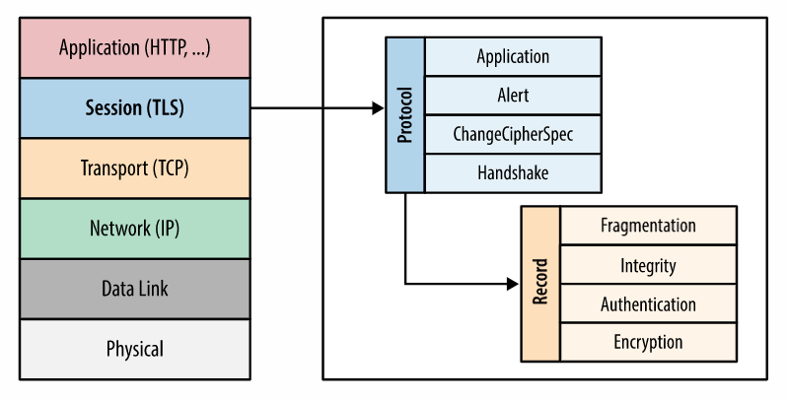
Client hello: The client sends a client hello message with the protocol version, the client random, and a list of cipher suites.
Server hello: The server replies with its SSL certificate, its selected cipher suite, and the server random. In contrast to the RSA handshake described above
Server's digital signature: The server uses its private key to encrypt the client random, the server random, and its DH parameter*. This encrypted data functions as the server's digital signature, establishing that the server has the private key that matches with the public key from the SSL certificate.
Digital signature confirmed: The client decrypts the server's digital signature with the public key, verifying that the server controls the private key and is who it says it is. Client DH parameter: The client sends its DH parameter to the server.
Client and server calculate the premaster secret: Instead of the client generating the premaster secret and sending it to the server, as in an RSA handshake, the client and server use the DH parameters they exchanged to calculate a matching premaster secret separately.
Session keys created: Now, the client and server calculate session keys from the premaster secret, client random, and server random, just like in an RSA handshake.
Client is ready:
Same as an RSA handshake.
Server is ready
Encryption
A mechanism to obfuscate what is sent from one host to another.
Authentication
A mechanism to verify the validity of provided identification material.
Integrity
A mechanism to detect message tampering and forgery.

Slide 2
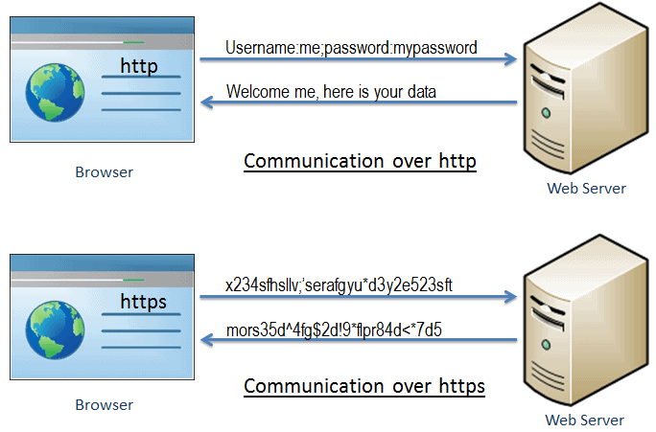
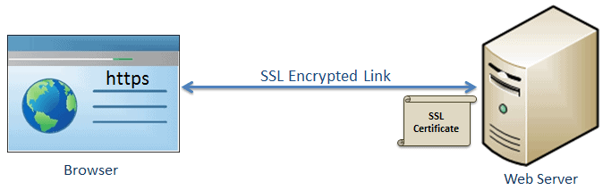
SSL stands for Secure Sockets Layer, and it refers to a protocol for encrypting and securing communications that take place on the Internet. Although SSL was replaced by an updated protocol called TLS (Transport Layer Security) some time ago, "SSL" is still a commonly used term for this technology.

Slide 3
Advantage of https
Secure Communication: https makes a secure connection by establishing an encrypted link between the browser and the server or any two systems.
Data Integrity: https provides data integrity by encrypting the data and so, even if hackers manage to trap the data, they cannot read or modify it.
Privacy and Security: https protects the privacy and security of website users by preventing hackers to passively listen to communication between the browser and the server.
Faster Performance: https increases the speed of data transfer compared to http by encrypting and reducing the size of the data.
SEO: Use of https increases SEO ranking. In Google Chrome, Google shows the Not Secure label in the browser if users' data is collected over http.

Slide 4






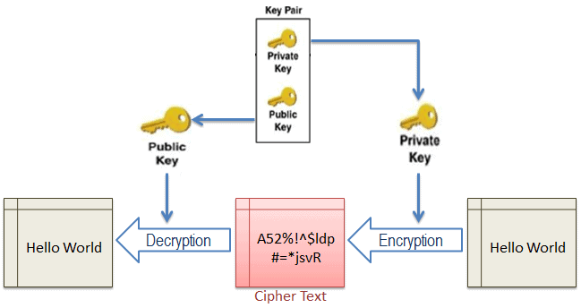
plain
plain
cypher
asymmetric encryption there are two keys: one public key to encrypt and a private key to decrypt. From this concept, one of the names of asymmetric encryption is derived: public key encryption
encryption
Different key use for
Encryption & Decryption
decryption
Asymmetric
Secure communication begins with a TLS handshake, in which the two communicating parties open a secure connection and exchange the public key
During the TLS handshake, the two parties generate session keys, and the session keys encrypt and decrypt all communications after the TLS handshake
Different session keys are used to encrypt communications in each new session
TLS ensures that the party on the server side, or the website the user is interacting with, is actually who they claim to be
TLS also ensures that data has not been altered,
since a message authentication code (MAC)
is included with transmissions

Slide 5





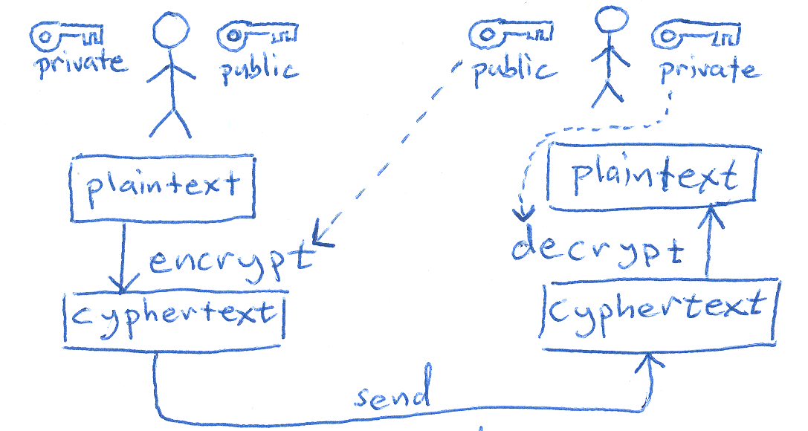






Asymmetric
c
s
Public
PUBLIC
PRIVATE

Slide 6
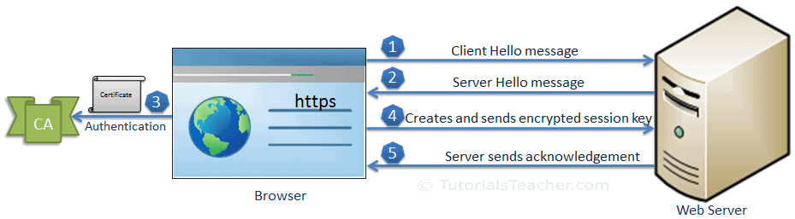
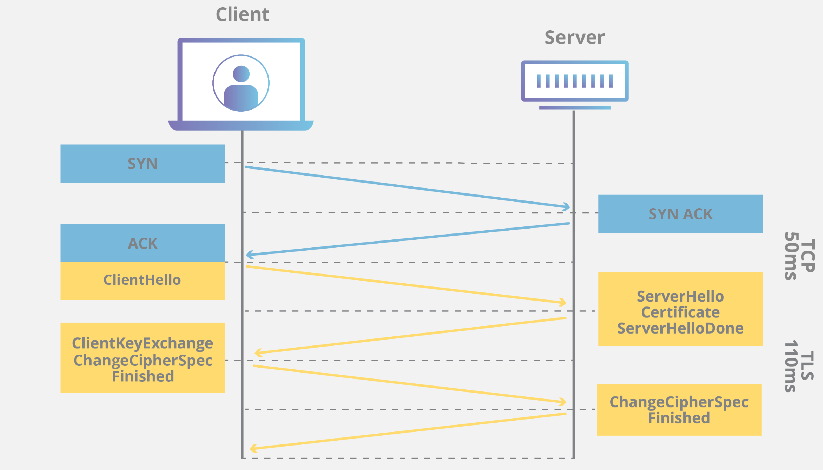
The communication over SSL always begins with the SSL handshake. The SSL handshake is an asymmetric cryptography which allows the browser to verify the web server, get the public key and establish a secure connection before the beginning of the actual data transfer.

